Slide 1



Grade 6

Slide 2
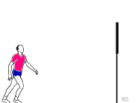
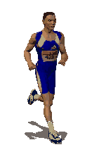


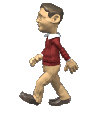
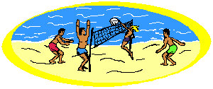

Unit 10

Slide 3

Grammar Review

Slide 4

Do as shown between brackets:
1- I ( play ) tennis last weekend.
(correct the verb)
2- I am going to join a club tomorrow.
( ask a question)

Slide 5

Check your answers.

Slide 6
1- I ( play ) tennis last weekend.
(correct the verb)
1- I played tennis last weekend.

Slide 7
2- I am going to join a club tomorrow.
(ask a question)
When are you going to join a club?
What are you going to do tomorrow?

Slide 8

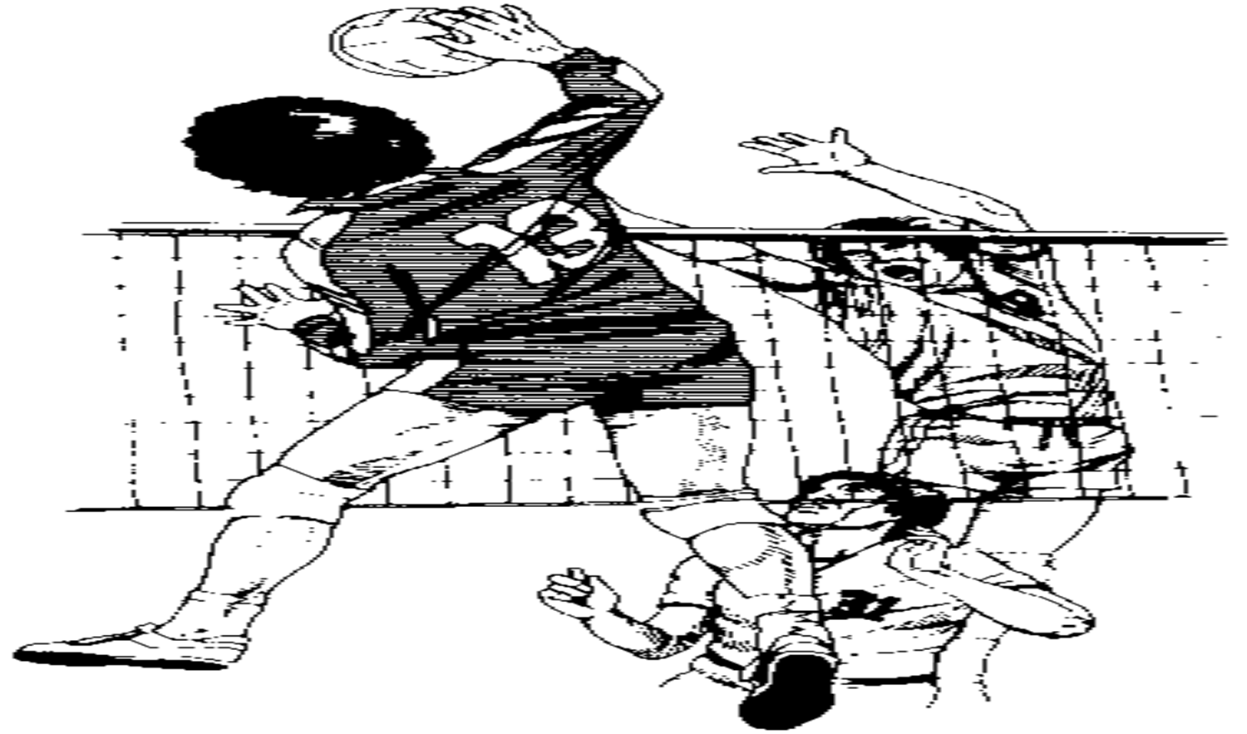
Can you say a sport which begins with the letter v?

Slide 9

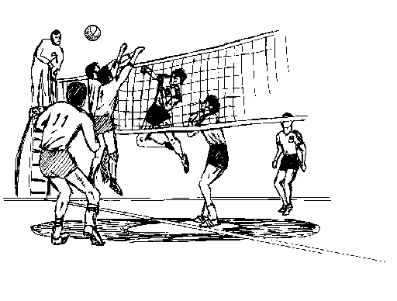
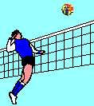
Do you like playing volleyball?

Slide 10

Student’s Book
Page 81

Slide 11


Slide 12
What are these two girls doing?
Before you listen , can you guess :
They are talking on the phone.
They are phoning each other.

Slide 13
Why do you think they are phoning each other?
Or may be they are planning for this weekend.
May be they are talking about school.
Or they are talking about sports.

Slide 14

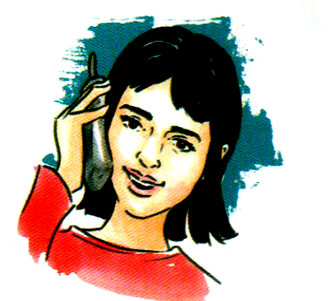

Now ,Listen carefully. Then choose the sports they like.

Slide 15

Check your answers!

Slide 16


